Slide 1


SANTANDER CUSTOMER SATISFACTION
AI-1 COURSE
RATNA, SAMBHAV, AASHRUTI AGRAWAL, JOYSON CHACKO GEORGE , BINIT SENGUPTA

Slide 2
INTRODUCTION
Santander customer satisfaction was a Kaggle competition back in year 2016. It is a classification machine learning problem statement where the objective is
Preprocessing and Cleaning of the data
Exploratory Data Analysis.
“to build a machine learning model to predict the whether the customer is dissatisfied with their services.”
Base Model and emsemble model building
This will help the company to understand their users and will help them understand the scope of improvement in their services. Also, it is general tendency of any user to switch the services if there are dissatisfied rather then reporting the reason of dissatisfaction.
Experimentation with different evaluation metric
Interpretation and conclusion

Slide 3
INTRODUCTION
Identifying and handling null values
Finding duplicates
Feature scaling
Splitting the dataset
Applying resampling techniques to balance dataset
Importing
Data processing
Model Creation
Result & Inferences
Logistic base model, with t-value & p-value based feature selection.
Importing dataset
Decision tree classifier with feature importance
Importing libraries
Random forest classifier, with feature selection using permutation importance
Adaboost classifier, ensembled DT based adaboost classifier, logistic regression based adaboost classifer
Xgboost classifier

Slide 4
METHODOLOGY
1.
2.
About Dataset
Packages
Pandas – Data manipulation
Numpy – Data Wrangling
Matplotlib – Data Visualization
Seaborn – Data Visualization
Sklearn – Machine learning model building &
metric evaluation
Imblearn – resampling of data
Xgboost – implement Xgbosst algorithm
Prettytable – for better representation
Dataset contain 371 features in the train set and 370 features in the test dataset.
The target features has two class labels , 0 indicating satisfied customers while 1 denoting unsatisfied customers. This dataset is heavily imbalanced with ~96% of labels being 0.
Although, there were 371 features, by the end of data cleaning, model building was performed on 160 features.

Slide 5
METHODOLOGY
3.
4.
Data Preparation & EDA
ML Modelling
Checking null values, duplicated values
Understanding the dataset – identifying zero variance features, correlated predictors, and sparse features.
Plotted the number of unique values.
Visualized the target columns and observed the class imbalance.
Handling class imbalance by first applying oversampling followed by undersampling.
Implemented logistic regression as base model, calculated features based on t value and p value
Decision tree with hyper parameter tuning, and calculated the feature importance.
Random forest was implemented with optimization of hyper parameters using GridSearchCV followed by plotting important features.
Adaboost, ensembled decision tree based adaboost, logistic regression based Adaboost classifiers with hyper tuning and calculated their feature importance.
Xgboost classifier were implemented with hyper parameter tuning and important features were plotted.

Slide 6
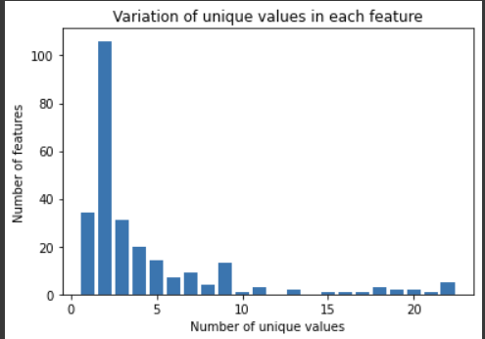
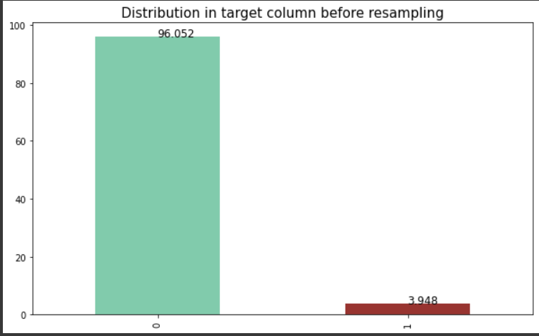
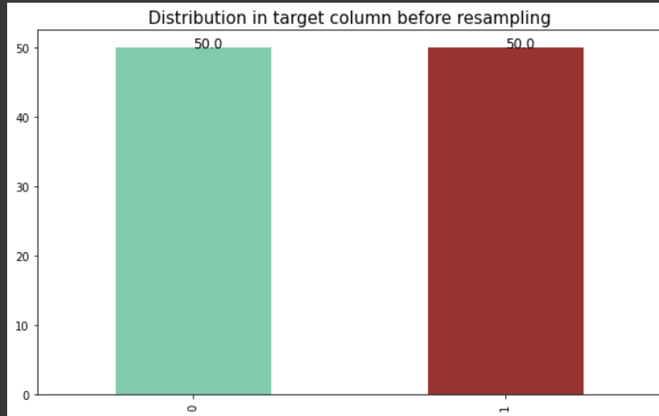
RESULTS
Data Preparation
No null values found
All the features with zero variance were dropped (Fig 1)
222 sparse features were identified and removed.
42 duplicate features were dropped.
133 predictors had >90% found via Pearson correlation method were dropped. Total 160 features were there for model building.
Heavily imbalanced dataset (~96% satisfied customers) was balanced using SMOTE followed by under sampling.
Fig 1
Resampling
SMOTE + Under sampling

Slide 7
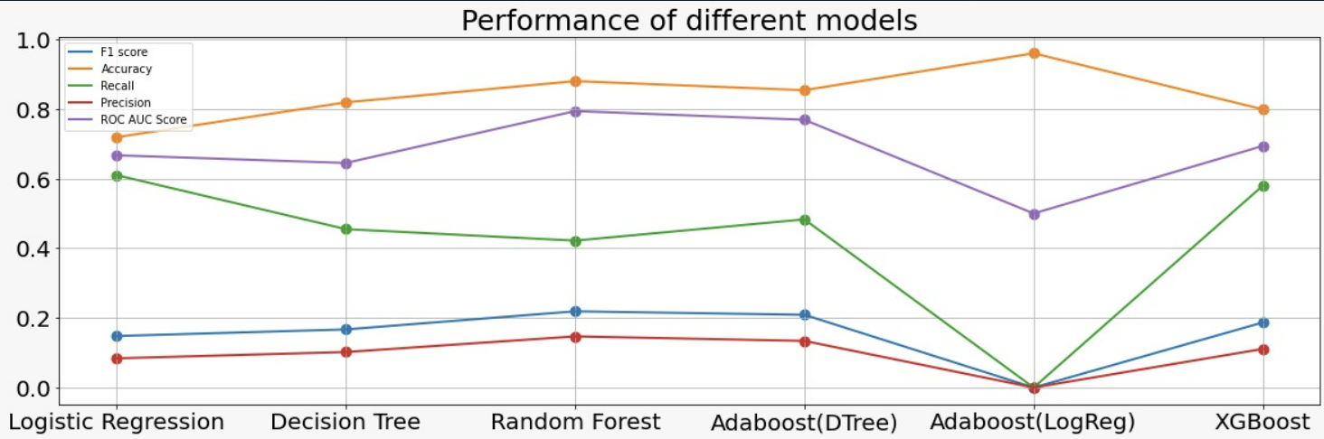
RESULTS
ML Modelling
The best model on chosen evaluation metric i.e. ROC AUC score was Random Forest. However, logistic regression ensembled Adaboost failed badly although it showed high accuracy.

Slide 8
CONCLUSION
Data preprocessing was performed on the dataset and out of 369 features, 160 features were finally taken for model building and prediction.
Ensemble models are performing better than the base models like Logistic Regression and Decision Tree for obvious reasons. Improvement in performance in ensemble models is considerable for ROC AUC score but not enough for Precision which in this case is the most important score.
Random forest had performed best with roc score of 0.8023.
Accuracy score is high for most of the models but since test set is unbalanced with majority class as 'satisfied', we cannot use accuracy score as our evaluation metric. As an example, Adaboost with Logistic Regression as its base estimator is giving 93% accuracy but it is actually the worst model because its ROC AUC score and precision is 0.
Final conclusion would be, if we have an unbalanced dataset, a lot of attention has to be given towards Data Preparation process, because data preparation becomes a pivotal step for the better performance of the models.

Slide 9
IMPROVEMENTS THAT CAN TO DONE
Data Preparation Strategy: We need more robust data preparation strategy by developing a deeper understanding of the dataset. Precision scores were consistently low for all of our models, which is a direct result of a poor data preparation. There is no single method for handling imbalance, so we need to iterate through its different methods and select the one which works best for our case. Outlier detection and elimination also might be an important step to get better results.
Handling Features: Improvement is needed towards better filtering of the columns in terms of variance in them, their contribution towards the response variable, etc. Identifying features is also critical to since it will enable us to categorize them in different sets and then try to understand how a particular set is correlated to target variable, can give us huge insight into the data. But this step requires in depth literature review, thus can be done as a future work.

